Slide 1

ImageMedix
By Team 5 The Minions
Sprint 0

Slide 2
Agenda
Team Member Roles and Responsibilities
Problem Statement
Project Description
Personas
Technologies
Algorithms
Project Schedule
Team Working Agreement
Retrospective
Group Wikipage Link

Slide 3
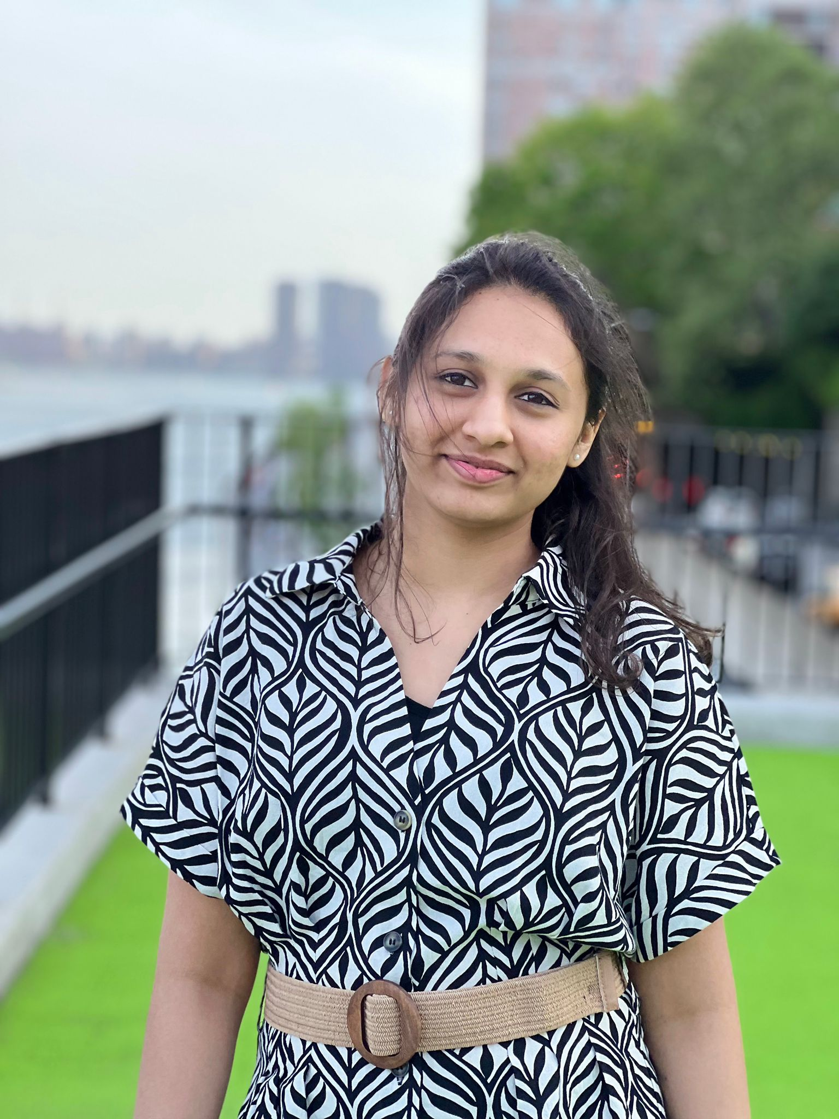
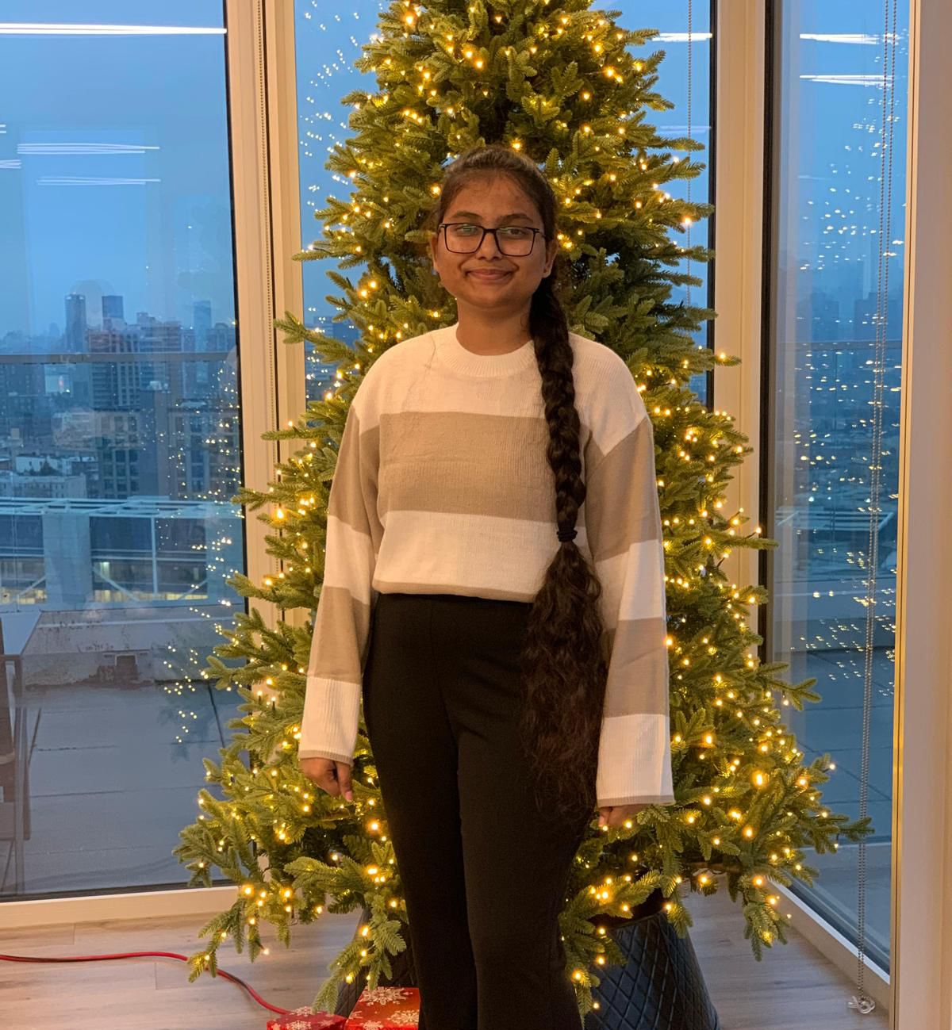

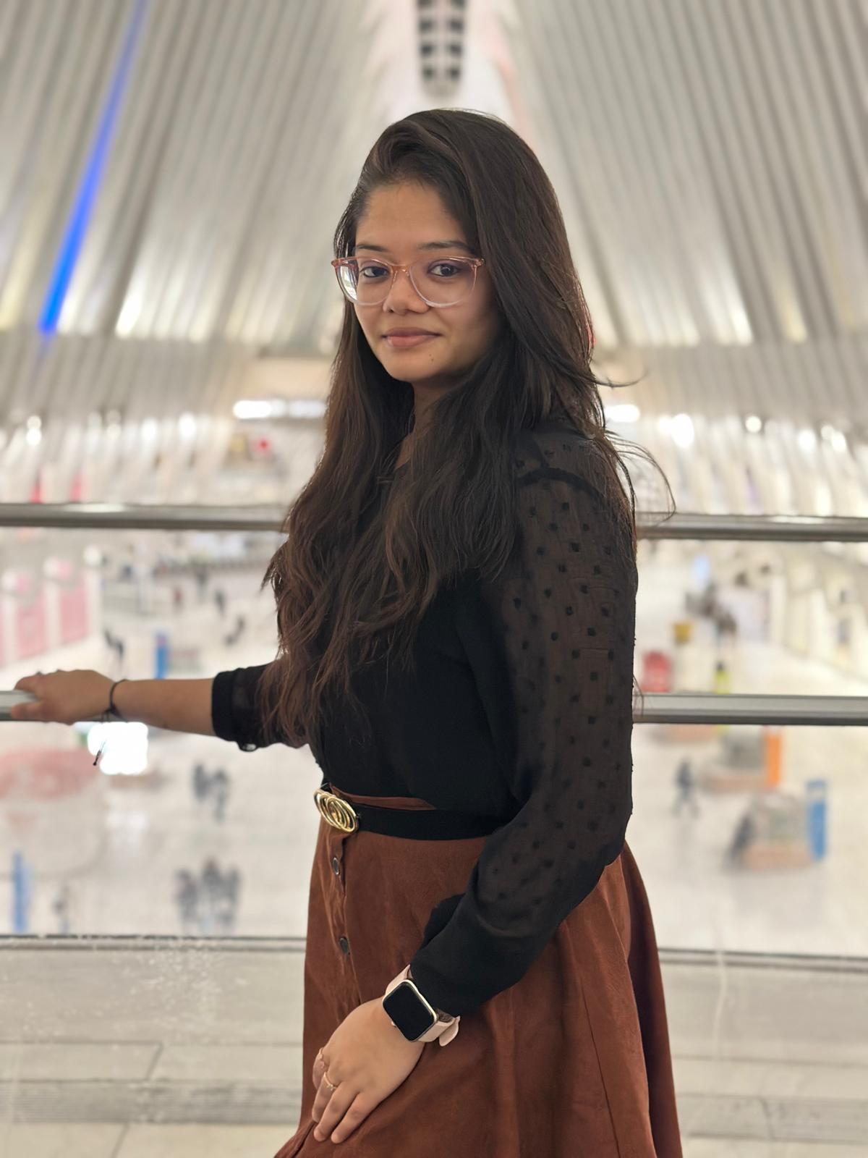
Team Members – machine learning
Vaishnavi Chandrasekar
Christiana Heden Kothuru
Deepika Mothkuri
Greeshma Kenche

Slide 4

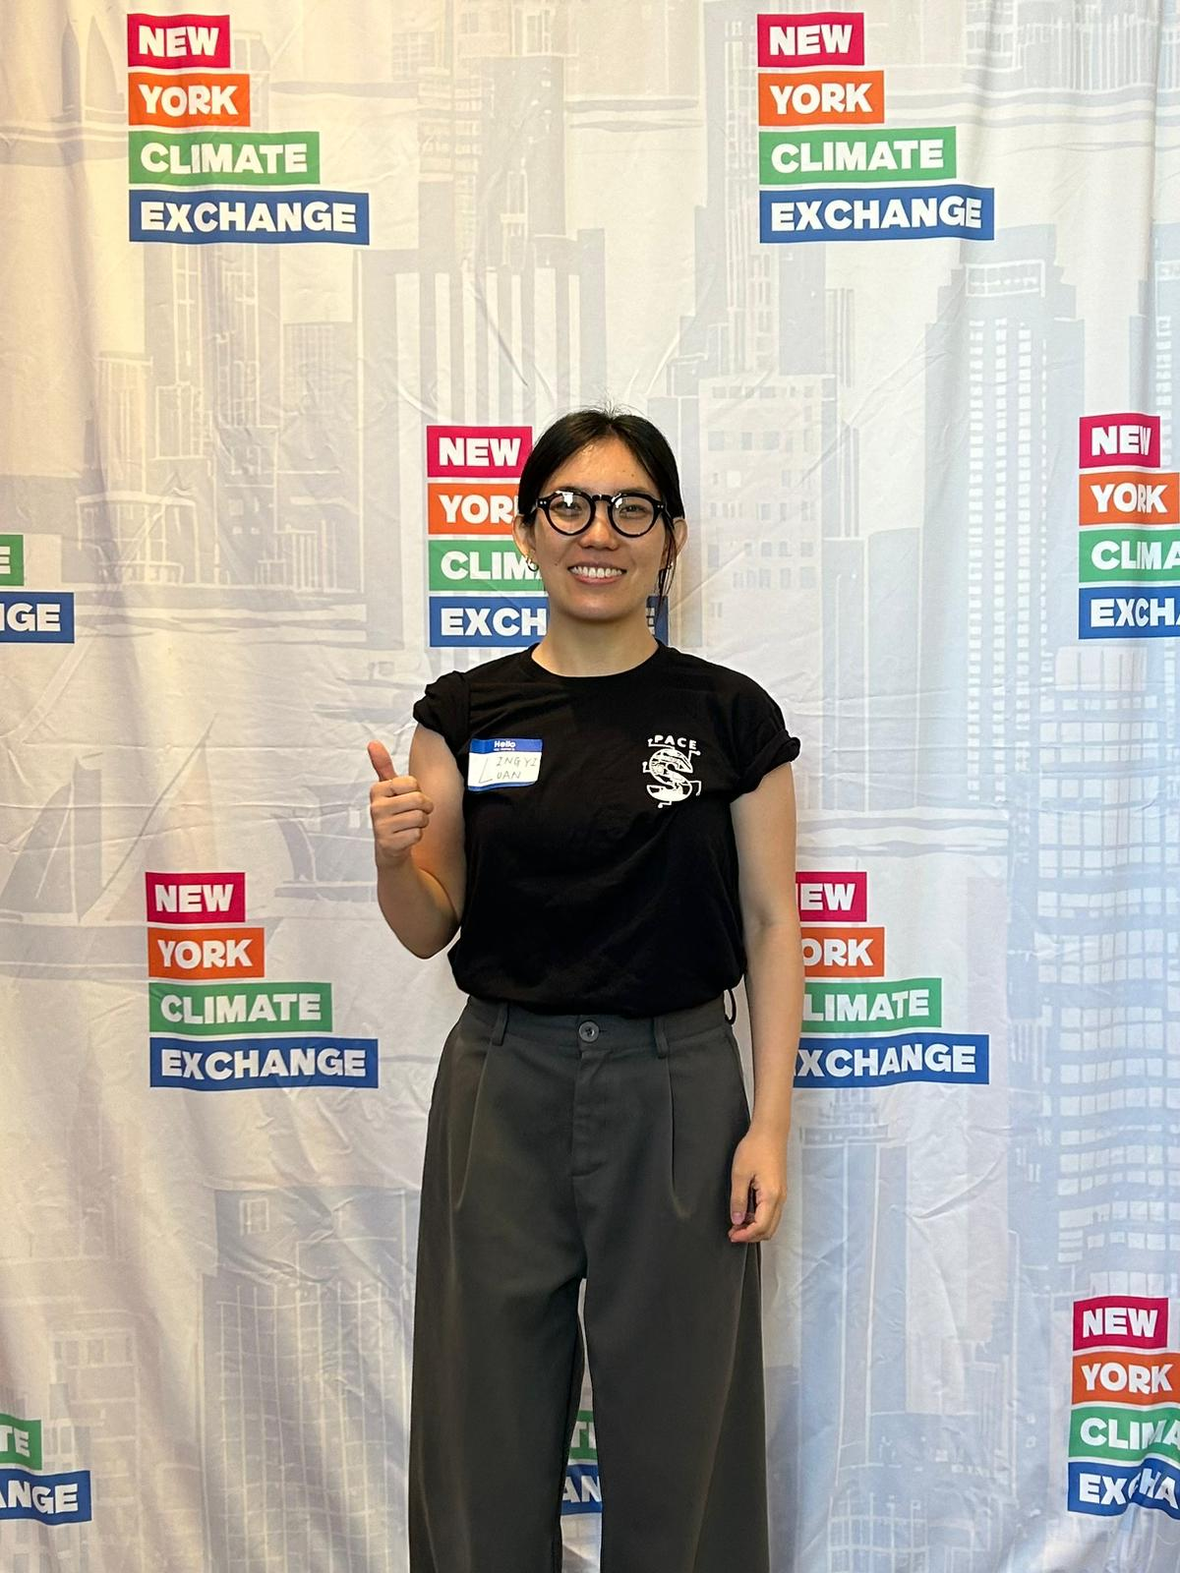
Team Members – Backend
Yucong Hu
Lingyi Luan

Slide 5


Team Members – Frontend
Yash Bhanubhai Panchani
Rameez Ahmed Shaik

Slide 6

Problem statement
Many healthcare facilities face challenges in diagnosing pneumonia and brain tumors quickly and accurately, often due to limited access to specialists and high workloads. Current solutions typically require separate systems to analyze different types of medical images. This leads to inefficiencies in diagnosis and delays in providing critical care. There is a need for an automated system that can efficiently classify medical images and provide preliminary diagnoses to support healthcare professionals in making timely decisions.

Slide 7
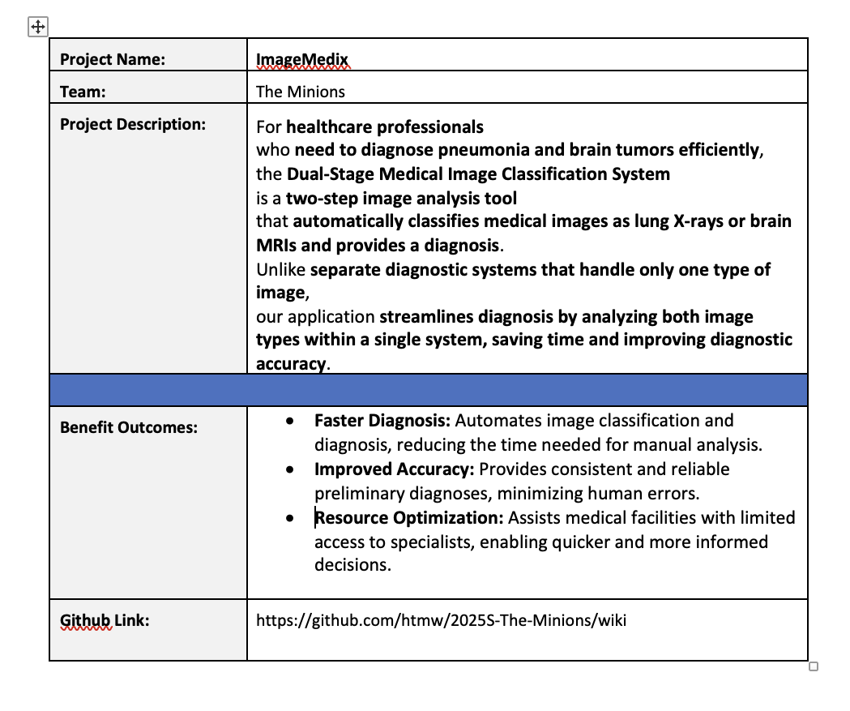
Project description

Slide 8
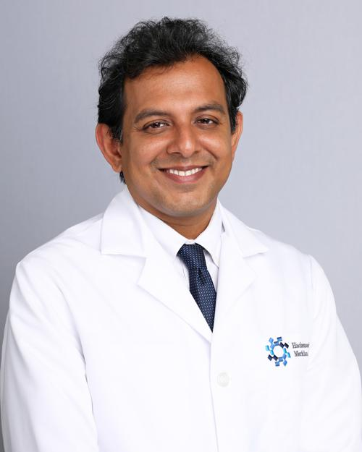
Personas
Dr. James Patel (Radiologist)
Age: 45
Occupation: Senior Radiologist at a metropolitan hospital
Background: Over 20 years of experience in diagnostic imaging, specializing in lung and brain disorders. Known for mentoring junior doctors in radiology.
Goals: To reduce the time spent analyzing large volumes of medical images while maintaining high diagnostic accuracy.
Challenges: Overloaded with image analysis requests and administrative duties, leading to delays in diagnosis and increased stress.
How the System Helps: Automates initial image classification and diagnosis, allowing Dr. Patel to prioritize critical and complex cases efficiently.

Slide 9

Personas
Dr. Suzen Chen (General Practitioner)
Age: 38
Occupation: General Practitioner at a rural healthcare clinic
Background: Has served in underserved regions for over a decade, often working without the immediate support of medical specialists. Committed to improving healthcare access in remote areas.
Goals: To provide fast, accurate diagnoses for patients despite limited access to specialists.
Challenges: She m ust handle a wide variety of cases on her own, making it difficult to diagnose complex conditions such as brain tumors and pneumonia accurately.
How the System Helps: The AI system offers reliable preliminary diagnoses for brain and lung conditions, helping Dr. Chen make timely and informed treatment decisions.

Slide 10
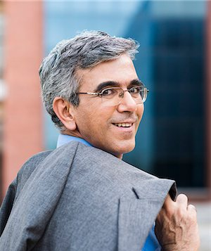
Personas
Dr. Raj Aryan (Healthcare Director)
Age: 50
Occupation: Director of a large hospital chain in India
Background: A visionary healthcare leader who has overseen the expansion of multiple hospitals across the country. Inspired by challenges faced in rural and semi-urban healthcare delivery.
Goals: To improve diagnostic efficiency, reduce patient wait times, and implement AI-based healthcare solutions across all branches.
Challenges: Delays in diagnosis caused by a shortage of skilled radiologists, leading to overcrowded hospitals and slow patient care.
How the System Helps: The automated system accelerates diagnosis processes across multiple hospitals, enabling faster and more efficient patient care, particularly in resource-constrained facilities.

Slide 11






Technologies
Frontend: React.js
Used to create a user-friendly interface that allows healthcare professionals to upload and view medical images easily.
Backend: Node.js (API), Flask (Model Inference), MongoDB
Node.js: Handles API requests and manages communication between the frontend and backend services.
Flask: Supports model inference by running machine learning models for image classification and diagnosis.
MongoDB: Stores user data, images, and diagnostic results, enabling secure and scalable data management.
Machine Learning:
Built using PyTorch and trained on datasets for lung X-rays and brain MRIs.
Cloud Infrastructure:
Deployed using AWS.

Slide 12
Algorithms
The system uses two core algorithms based on pre-trained deep learning models. A ResNet model, fine-tuned on a dataset of medical images, is used to classify whether the uploaded image is a lung X-ray or a brain MRI. Depending on the classification result, the system proceeds to a second stage. For lung X-rays, a fine-tuned EfficientNet model detects and classifies pneumonia into normal, viral, or bacterial categories by analyzing lung patterns. For brain MRIs, the same EfficientNet model is used to detect and classify brain tumors into glioma, meningioma, or no tumor by identifying abnormalities in brain structures. These models provide high accuracy and efficiency, ensuring reliable diagnoses for both image types.

Slide 13
Project Schedule
Sprint 0 (Project Initiation): (January 21 – February 10)
Focus on idea development, project planning, and setting up initial deliverables, including a presentation and wiki update.
Sprint 1 (Core Development): (February 10 – March 10)
Begin core system design and implementation, including frontend, backend, and machine learning model integration. Deliverables: presentation and wiki update.
Sprint 2 (Advanced Development): (March 10 – April 7)
Continue development with a focus on refining model performance, system integration, and additional features. Deliverables: presentation, technical paper update, and wiki update.
Sprint 3 (Final Testing and Optimization): (April 7 – April 28)
Conduct system testing, performance improvements, and final documentation updates. Deliverables: presentation, technical paper update, and wiki update.

Slide 14
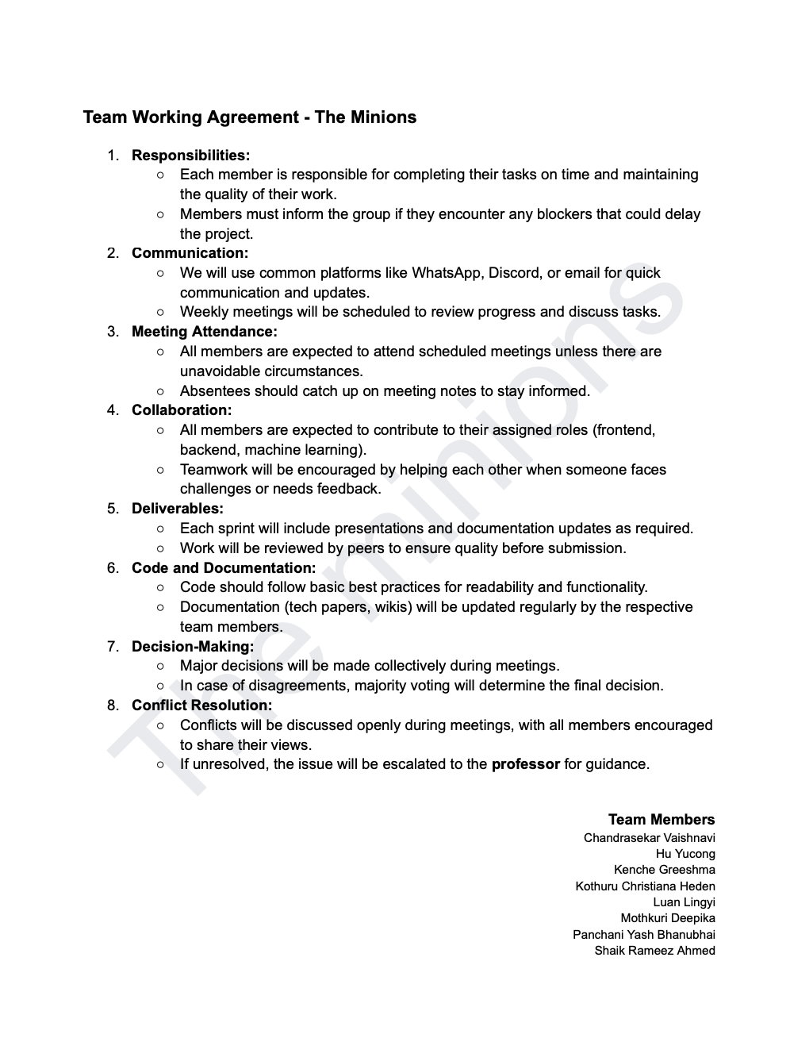
TEAM WORKING AGREEMENT

Slide 15

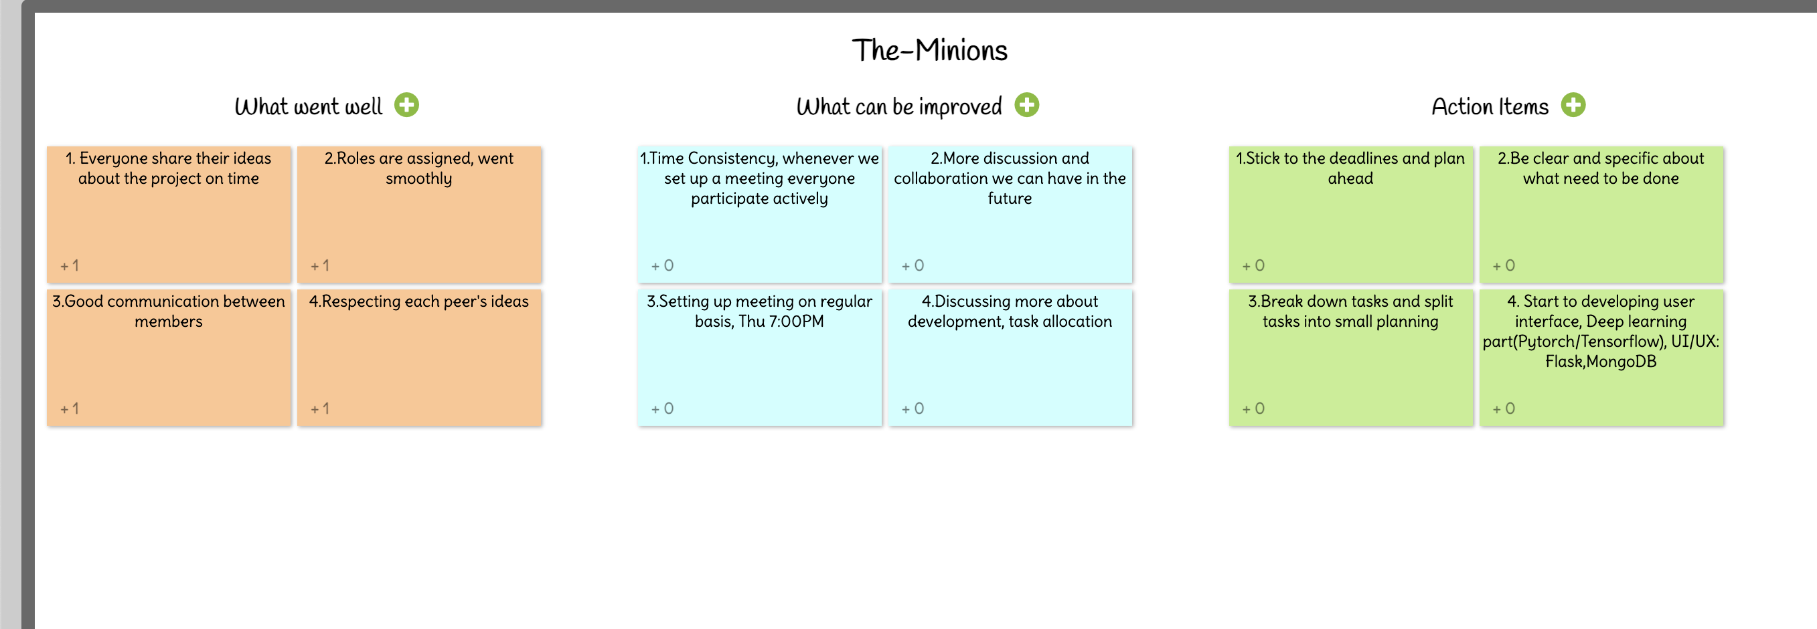
rETROSPECTIVE

Slide 16
Wikipage linK
https://github.com/htmw/2025S-The-Minions/wiki

Slide 17
tHANK YOU

